Slide 1
Prediction/forecast methods

Slide 2
Time intervals
Prediction period: it is the unit of time on which forecast is based. E.g. one month
Prediction horizon: it is the unit of time, defined as multiple of prediction period, associated to the duration for which we are interested to compute a forecast. E.g. one year prediction horizon based on 12 prediction periods

Slide 3
Classification of methods
Qualitative, based on experts (not taken into account hereinafter)
Regressions: based on the prediction of one variable as a function of other variables
Based on historical series

Slide 4
Regression
X is a vector of independent variables
Y is the (vector of) dependent variable
The problem is to identify the interpolation function Y=F(x)

Slide 5
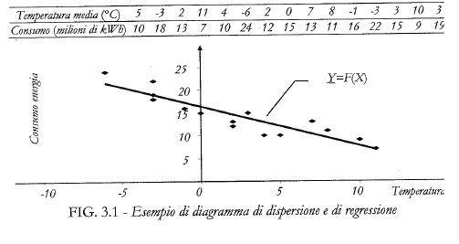

Slide 6
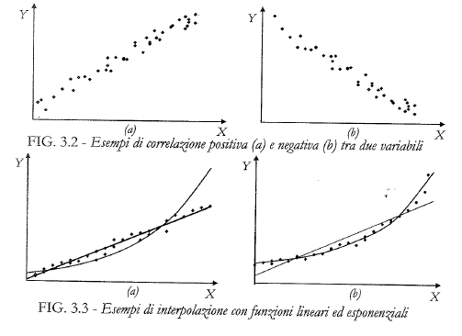

Slide 7



Linear regression
N observations of X and Y
Value of Y computed by F(.)
Difference between measure and expected value

Slide 8

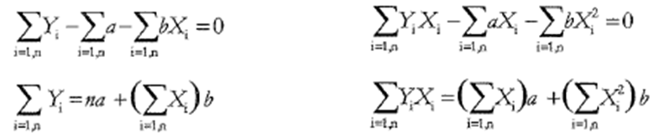

Slide 9
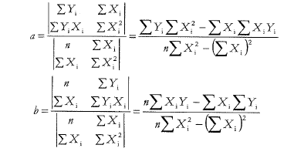

Slide 10
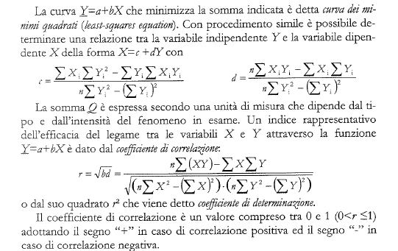


Consider:
The correlation coefficient is defined as:
-1<=r<=1

Slide 11
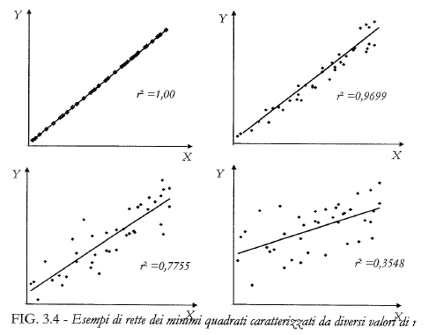

Slide 12
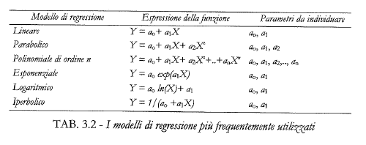

Slide 13
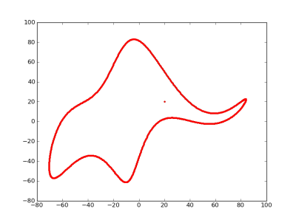
With four parameters I can fit an elephant, and with five I can make him wiggle his trunk*
In this case, N observations are perfectly interpolated by a polynomial of order N-1
*Attributed to von Neumann by Enrico Fermi, as quoted by Freeman Dyson in "A meeting with Enrico Fermi" in Nature 427 (22 January 2004) p. 297

Slide 14
Training, validation e jacknife
Good practice to verify the validity of the forecasting method is to identify the parameters of the method (training) and validate on another set of data (validation).
A typical and complete procedure is to carry out a training phase on the entire data set except for a sample, and check its effectiveness on the sample left out, repeating the procedure on all samples (jackknife).

Slide 15
Verification of the methods
In checking the effectiveness of the forecasting methods, two aspects are considered:
the estimate of the accuracy of the different forecasting methods to choose the most reliable;
monitoring and control over time of the effectiveness of the model chosen and any modification of the parameters.

Slide 16
Accuracy measurements
To evaluate the effectiveness of a forecasting method, the errors that would have been committed had been assessed if the estimation procedure had been applied in the past (T-1 errors are calculated).
Some indices can be obtained. Among the most common indices are:
mean absolute deviation - MAD
mean absolute percentage deviation - MAPD
the mean squared error (mean squared error - MSE).

Slide 17
mean absolute deviation – MAD
mean absolute percentage deviation – MAPD
the mean squared error MSE
MAPD_{T} | Quality
≤10% | Very good
[10%, 20%] | good
[20%,30%] | reasonable
>30% | unreliable

Slide 18

Smoothing

Slide 19
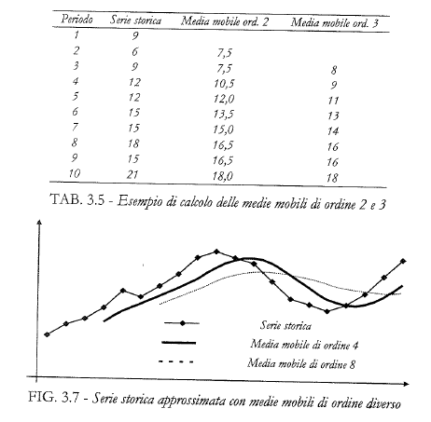

Slide 20
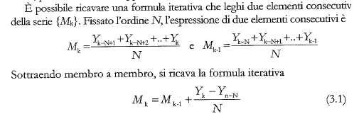

Slide 21
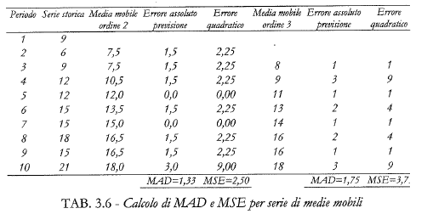

Slide 22

Weighted mobile average

Slide 23
Exponential average
The demand forecast in the next period is obtained using all historical data and attributing smaller weights to the "older" data, that is:
where α ∈ (0,1) is the exponential average constant.
Defining the forecast in T+1 as:
If the forecast error is positive (d_{T}>p_{T}), the forecast in T+1 decreases with respect to the forecast in T, it increases otherwise.

Slide 24
A crucial decision is the definition of α.
The forecast is lightly subject to random fluctuations in demand, but the most recent changes are introduced in the delayed forecast
α small
α large
High ability to quickly follow changes in demand, but low filtering of random components

Slide 25
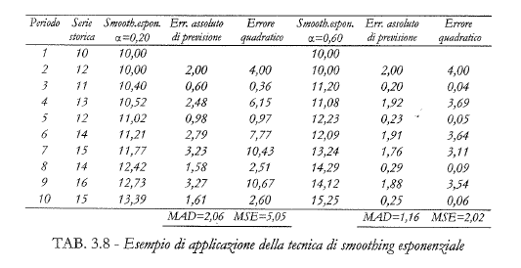

Slide 26
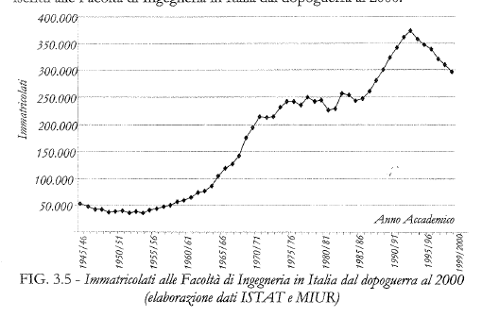
Historical series

Slide 27
Components
Long period (trend T): horizon of years
Cyclic (C): horizon of years
Seasonal (S): one year horizon
Random (random R): stochastic component, possibly on which to propose regression analyzes

Slide 28
Forecast of an historical trend
Product: the forecast Y is Y=T*C*S*R
usually preferred as it is possible to define percentages of increase/decrease
Sum: the forecast Y is Y=T+C+S+R

Slide 29
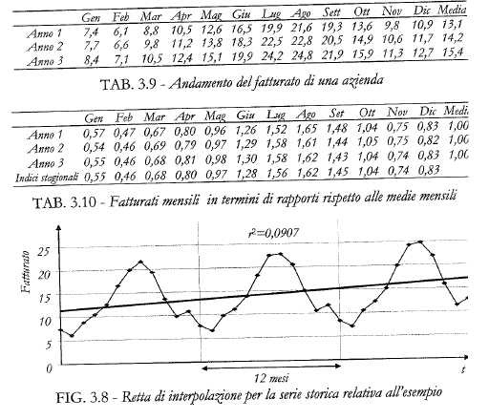
Seasonal components

Slide 30
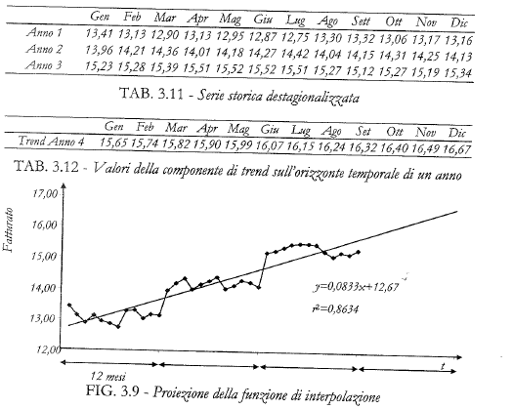

Slide 31
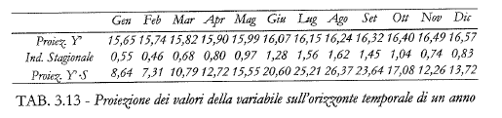
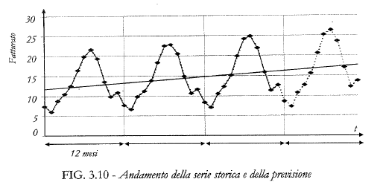

Slide 32
Computation of seasonal indexes
Deseasonalisation of the historical trend
Identification of the function interpolating the historical series with no seasonal component
Forecast in future periods

Slide 33
